Slide 1
A numerical example of LSTMs

Slide 2
Basics
The input gate allows new information to flow into the network. It has parameters W_i, b_i, where i stands for input.
The memory cell preserves the hidden units information across time steps. It has parameters W_c, b_c, where c stands for cell.
The forget gate allows information which is no longer pertinent to be discarded. It has parameters W_f, b_f, where f stands for forget.
The output gate allows what information will be output to the screen and what will be propagated forward as part o

Slide 3
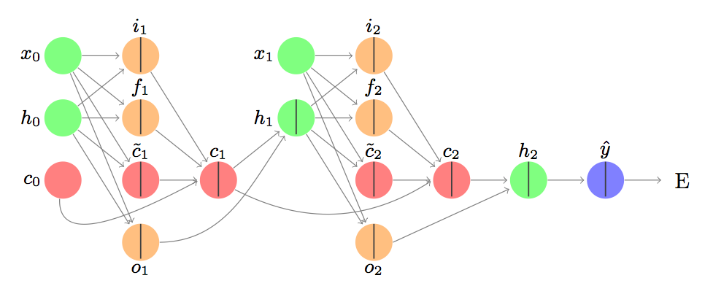
LSTM with two cells:

Slide 4
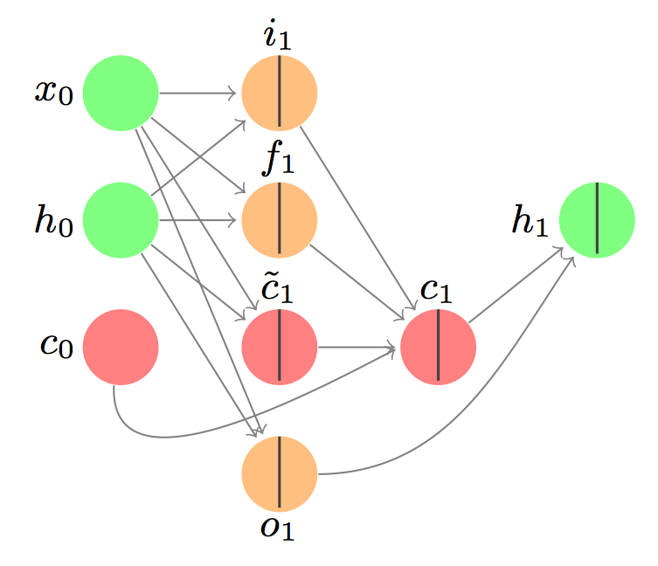
First cell
Green circles indicate input.
Red circles indicate the memory cell.
Orange circles are gates. In real life, a gate can be partially open, fully open, or closed.
The line down the centre of some of the circles indicates that the circle (the neuron) has some net input and an activation function.

Slide 5
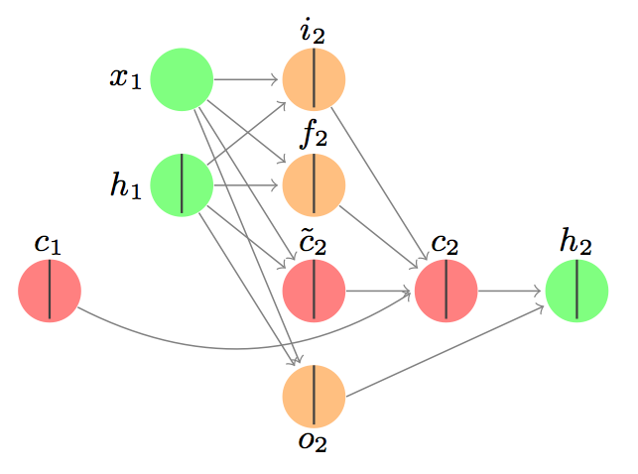
Second cell
Green circles indicate input.
Red circles indicate the memory cell.
Orange circles are gates. In real life, a gate can be partially open, fully open, or closed.
The hidden state from the previous layer is h_1, which was the result of a calculation, so this neuron has a dividing line. All of the connections are the same. The hidden state h_2 is not input for the next cell because there is no next cell.

Slide 6
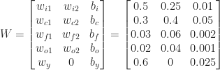
Walk-through: forward
input sequence x_0 = 0.1, x_1 = 0.2.

Slide 7
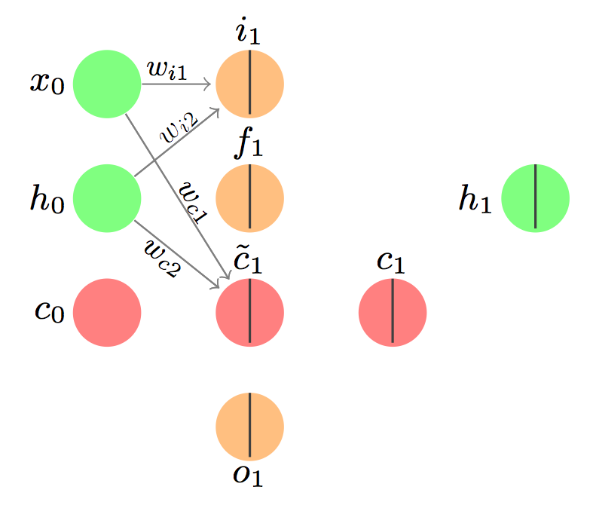
The input gate
Our input is [x_0, h_0, c_0], the initial sequence input, the initial hidden value, and the initial memory value. This translates to [0.1, 0, 0]
The full computation is:
This value can be interpreted as the probability that we will allow the information from x_1 to enter the memory cell.

Slide 8
More on input gate
This value can be interpreted as the probability that we will allow the information from x_1 to enter the memory cell.
The usual practice is to keep that value 0.515 – that is, to keep the gate open. Alternatively, we could make a decision as to whether the information will go forward.
then allow the information through – open the input gate completely. This is referred to as making a stochastic decision. Depending on the decision, the gate would open (value 1) or close (value 0).

Slide 9

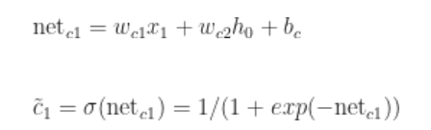
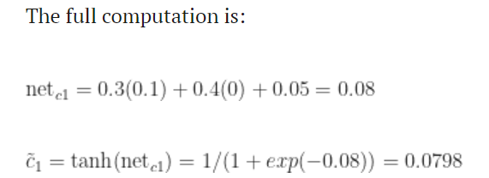
input gate is related to the memory cell

Slide 10
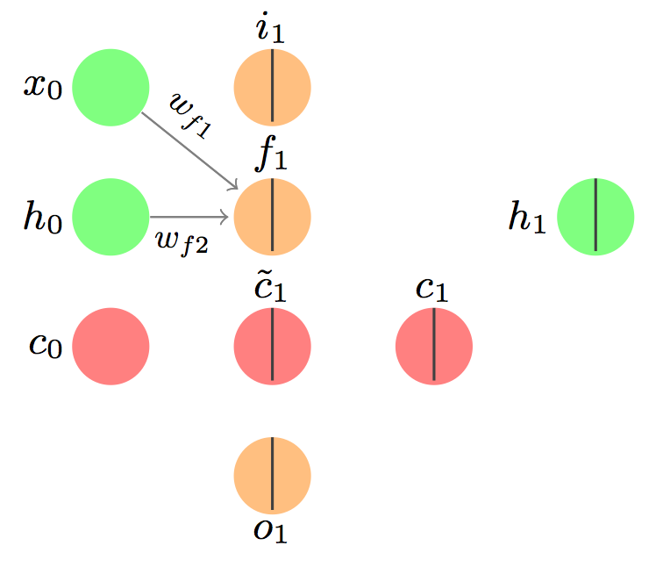
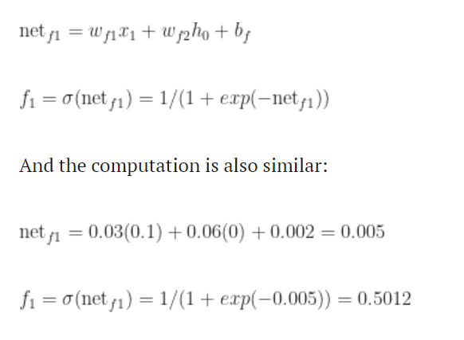
The forget gate
To decide what information needs to be removed from the network
Again, a stochastic decision could be made here as to whether the previous information should be forgotten (value 0) or allowed through (value 1). For the purposes of this example, let’s assume the value is 1.

Slide 11
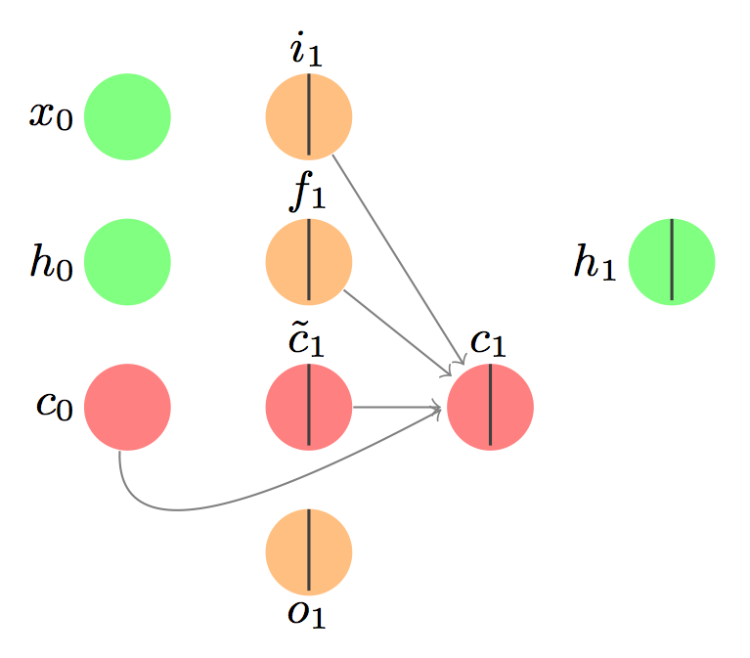


The memory gate
combine the new information from the input gate and remove the information we’re forgetting according to the forget gate.
The Hadamard product is an element-wise product.

Slide 12
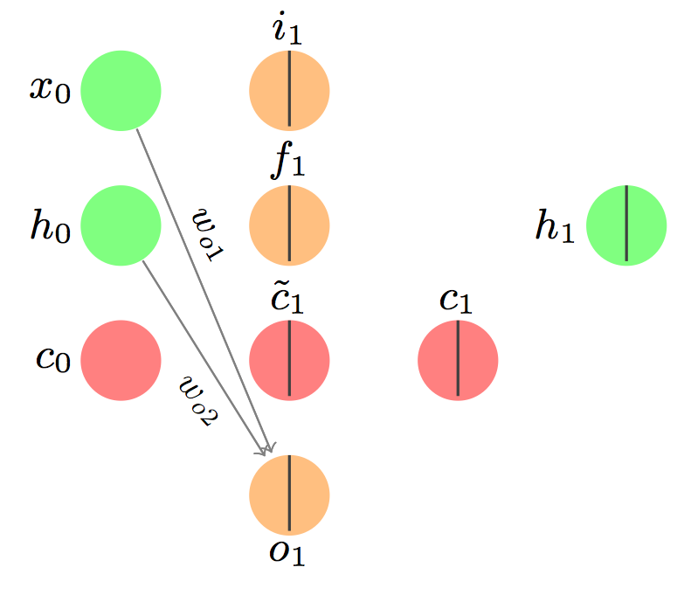
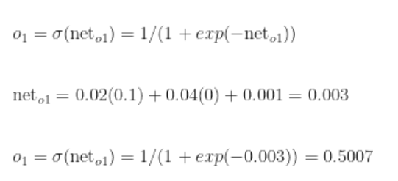

The output gate
In a sequence-to-sequence mapping task, like machine translation or image captioning, we might be interested in outputting a value (to the screen or to a file) for each input we see. Here, though, we have a single scalar output – essentially a regression task.
the stochastic decision results in a 1

Slide 13
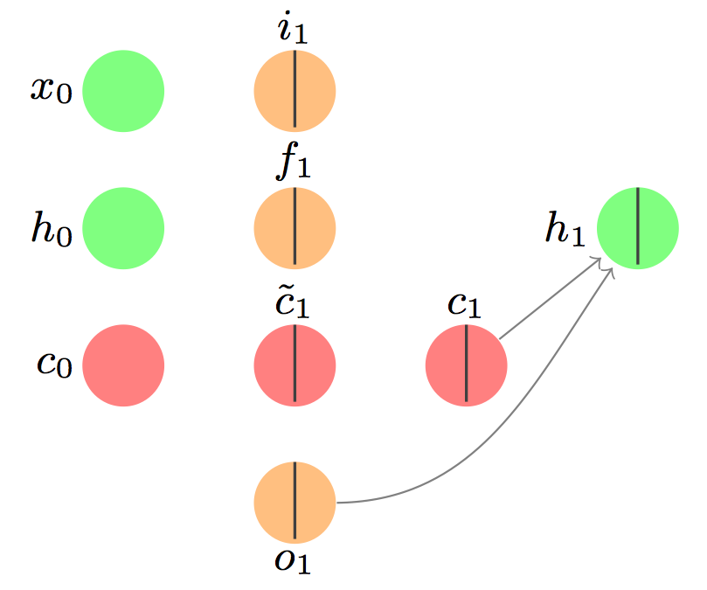
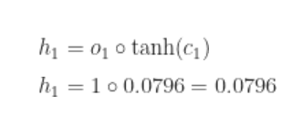
The hidden state
The hidden layer is separate from the memory cell, but very related.
The output gate decides whether the signal from the memory cell gets sent forward as part of the input to the next LSTM cell.

Slide 14
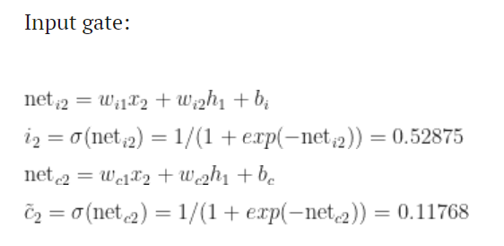
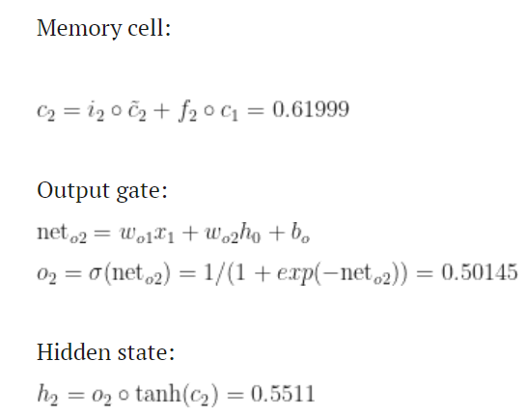
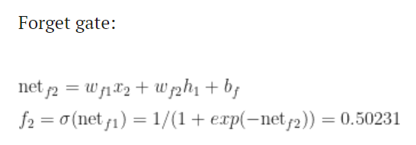
The second LSTM cell

Slide 15

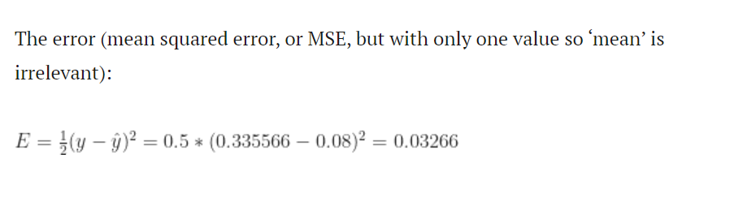
Final output

Slide 16


Walk-through: backward
delta_i to refer to the partial derivative of the error with respect to i

Slide 17
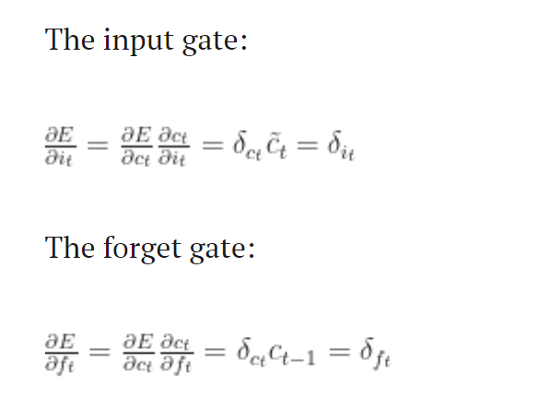
Go through the input and forget gates

Slide 18
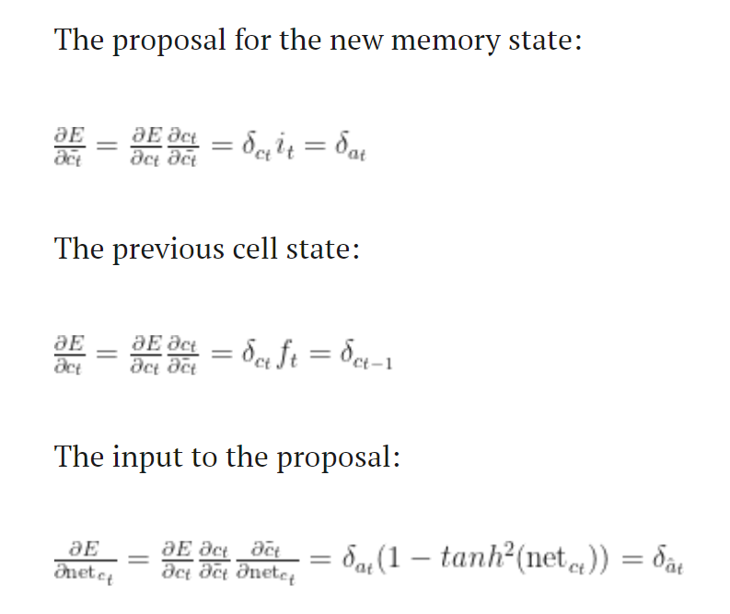

Slide 19
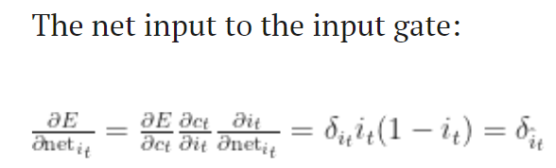
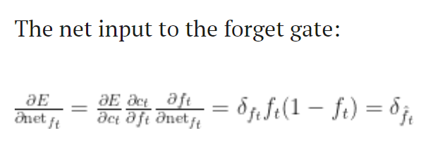
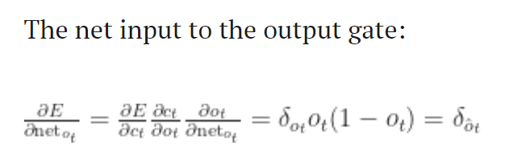
Net input to each gate

Slide 20
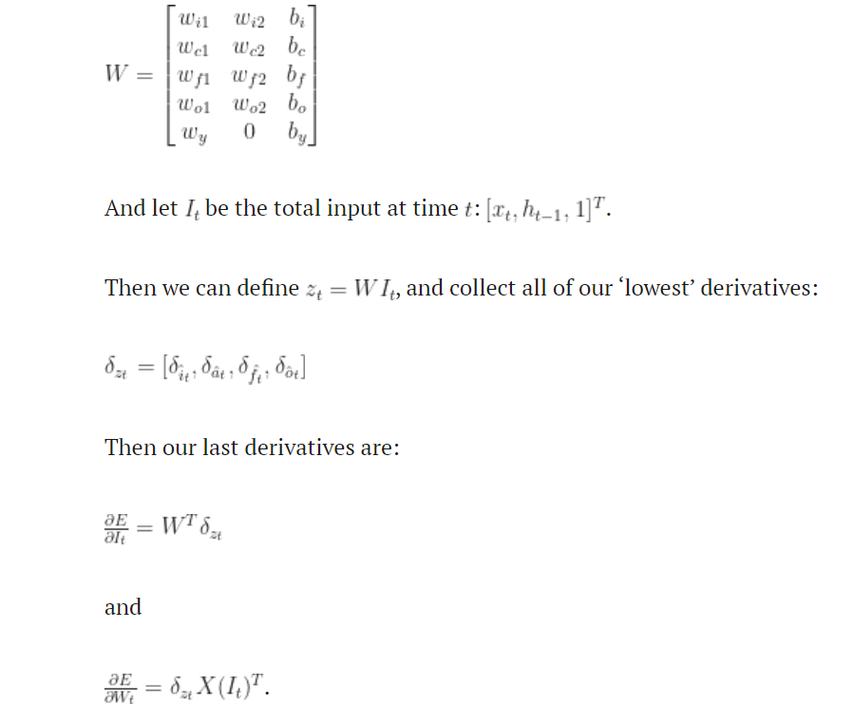
Final step

